Slide 1
Extract, transform, load
MTN.BI.08
Overview of ETL and SQL Review
Elias Nema
Senior Software Engineer
Elias_Nema@epam.com

Slide 2
Agenda
Data Warehousing Basics
Review of SQL*Plus
ETL Overview
“ETL” into the DWH

Slide 3
Data Warehousing Basics

Slide 4
Data Warehouse Characteristics
Strategic and tactical analyses can discern trends in data.
A significant portion of the data in a data warehouse is often read-only, with infrequent updates.
The data in source systems is not “clean” or consistent across systems.
The design required for an efficient data warehouse differs from the standard normalized design for a relational database.
The data warehouse often serves as a target for meaningful data found on Big Data platforms that optimally solve semi-structured data problems.

Slide 5
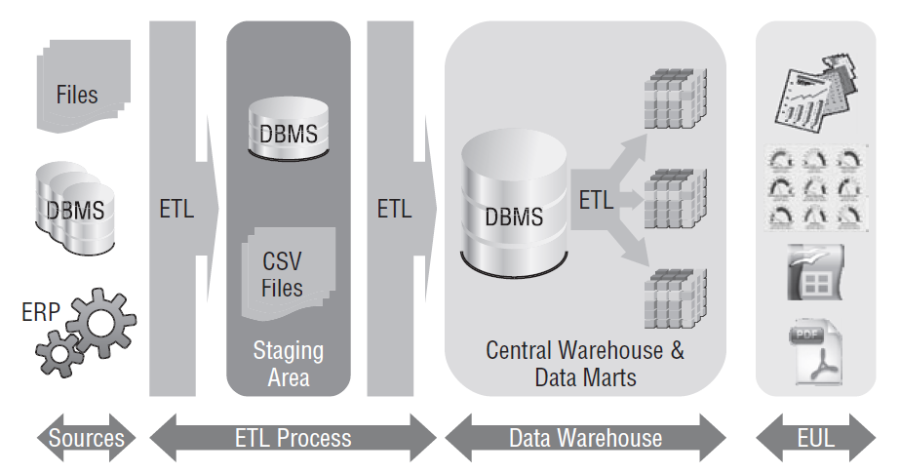
Basic DWH Architecture

Slide 6
Review of sql*plus

Slide 7
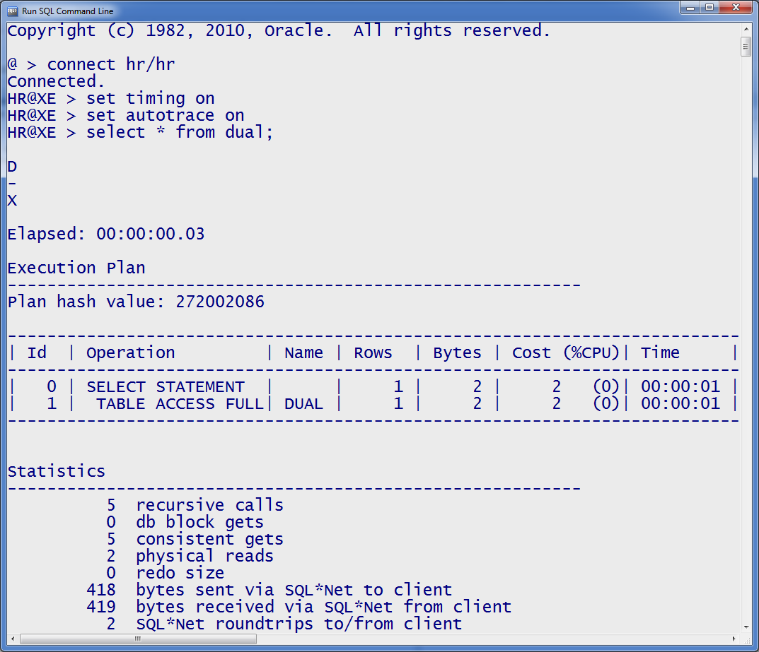
SQL*Plus
SQL*Plus is the most basic Oracle Database utility, with a basic command-line interface, commonly used by users, administrators, and programmers.
Connect to
Enable query execution time
Turn on statistics and execution path

Slide 8
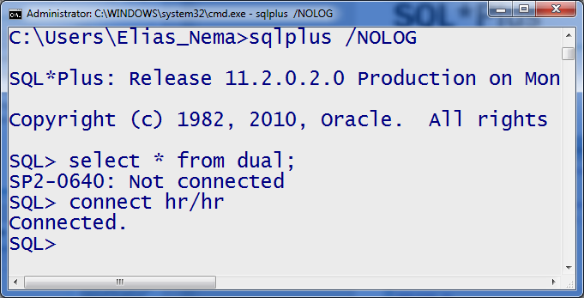
SQL*Plus
It’s not recommended to logon from cmd line, because some operating systems provide a way for other users to see your command-line arguments. You can instead use the /NOLOG option to start SQL*Plus without connecting to the database, and then supply the username and password via the CONNECT command.

Slide 9
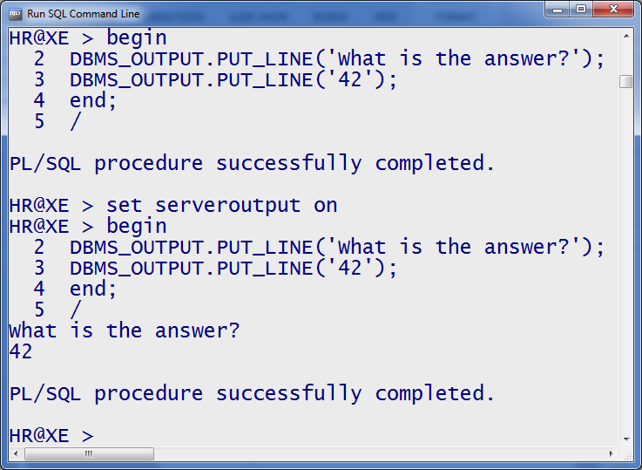
SQL*Plus
But, we can’t see output

Slide 10
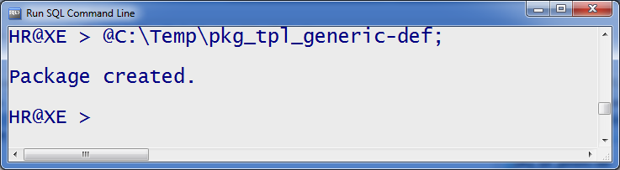
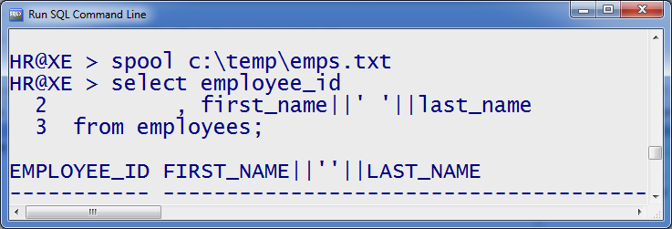
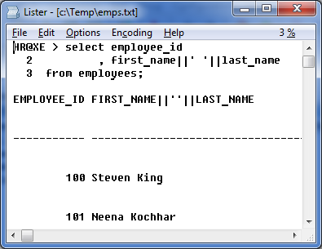
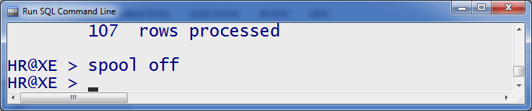
SQL*Plus
You can run any scripts with @ sign
…

Slide 11
Etl overview

Slide 12
So what is ETL
Extracts data from the source systems
Enforces data quality and consistency standards
Conforms data so that separate sources can be used together
Delivers data in a presentation-ready format so that application developers can build applications and end users can make decisions

Slide 13
34 ETL Subsystems
Three subsystems focus on extracting data from source systems.
Five subsystems deal with value-added cleaning and conforming, including dimensional structures to monitor quality errors.
Thirteen subsystems deliver data as dimensional structures to the final BI layer, such as a subsystem to implement slowly changing dimension techniques.
Thirteen subsystems help manage the production ETL environment.
Notes:
Data Profiling (subsystem 1) – Explores a data source to determine its fit for inclusion as a source and the associated cleaning and conforming requirements.
Change Data Capture (subsystem 2) – Isolates the changes that occurred in the source system to reduce the ETL processing burden.
Extract System (subsystem 3) – Extracts and moves source data into the data warehouse environment for further processing.
Data Cleansing System (subsystem 4) – Implements data quality processes to catch quality violations.
Error Event Tracking (subsystem 5) – Captures all error events that are vital inputs to data quality improvement.
Audit Dimension Creation (subsystem 6) – Attaches metadata to each fact table as a dimension. This metadata is available to BI applications for visibility into data quality.
Deduplication (subsystem 7) – Eliminates redundant members of core dimensions, such as customers or products. May require integration across multiple sources and application of survivorship rules to identify the most appropriate version of a duplicate row.
Data Conformance (subsystem 8 ) – Enforces common dimension attributes across conformed master dimensions and common metrics across related fact tables (see related article, “Kimball University: Data Integration for Real People”).
Slowly Changing Dimension (SCD) Manager (subsystem 9) – Implements logic for slowly changing dimension attributes.
Surrogate Key Generator (subsystem 10) – Produces surrogate keys independently for every dimension.
Hierarchy Manager (subsystem 11) – Delivers multiple, simultaneous, embedded hierarchical structures in a dimension.
Special Dimensions Manager (subsystem 12) – Creates placeholders in the ETL architecture for repeatable processes supporting an organization’s specific dimensional design characteristics, including standard dimensional design constructs such as junk dimensions, mini-dimensions and behavior tags.
Fact Table Builders (subsystem 13) – Construct the three primary types of fact tables: transaction grain, periodic snapshot and accumulating snapshot.
Surrogate Key Pipeline (subsystem 14) – Replaces operational natural keys in the incoming fact table record with the appropriate dimension surrogate keys.
Multi-Valued Bridge Table Builder (subsystem 15) – Builds and maintains bridge tables to support multi-valued relationships.
Late Arriving Data Handler (subsystem 16) – Applies special modifications to the standard processing procedures to deal with late-arriving fact and dimension data.
Dimension Manager (subsystem 17) – Centralized authority who prepares and publishes conformed dimensions to the data warehouse community.
Fact Table Provider (subsystem 18) – Owns the administration of one or more fact tables and is responsible for their creation, maintenance and use.
Aggregate Builder (subsystem 19) – Builds and maintains aggregates to be used seamlessly with aggregate navigation technologies for enhanced query performance.
OLAP Cube Builder (subsystem 20) – Feeds data from the relational dimensional schema to populate OLAP cubes.
Data Propagation Manager (subsystem 21) – Prepares conformed, integrated data from the data warehouse presentation server for delivery to other environments for special purposes.
Job Scheduler (subsystem 22) – Reliably manages the ETL execution strategy, including the relationships and dependencies between ETL jobs.
Backup System (subsystem 23) – Backs up the ETL environment for recovery, restart and archival purposes.
Recovery and Restart (subsystem 24) – Processes for recovering the ETL environment or restarting a process in the event of failure.
Version Control (subsystem 25) – Takes snapshots for archiving and recovering all the logic and metadata of the ETL pipeline.
Version Migration (subsystem 26) – Migrates a complete version of the ETL pipeline from development into test and finally into production.
Workflow Monitor (subsystem 27) – Ensures that the ETL processes are operating efficiently and that the warehouse is being loaded on a consistently timely basis.
Sorting (subsystem 28) – Serves the fundamental, high-performance ETL processing role.
Lineage and Dependency (subsystem 29) – Identifies the source of a data element and all intermediate locations and transformations for that data element or, conversely, start with a specific data element in a source table and reveals all activities performed on that data element.
Problem Escalation (subsystem 30) – Support structure that elevates ETL problems to appropriate levels for resolution.
Paralleling and Pipelining (subsystem 31) – Enables the ETL system to automatically leverage multiple processors or grid computing resources to deliver within time constraints.
Security (subsystem 32) – Ensures authorized access to (and a historical record of access to) all ETL data and metadata by individual and role.
Compliance Manager (subsystem 33) – Supports the organization’s compliance requirements typically through maintaining the data’s chain of custody and tracking who had authorized access to the data.
Metadata Repository (subsystem 34) – Captures ETL metadata including the process metadata, technical metadata and business metadata, which make up much of the metadata of the total DW/BI environment.

Slide 14
Metadata Challenge
Virtually all types of interactions with a database require the use of metadata, from datatypes of the data to business meaning and history of data fields.
One of the great challenges is to create a set of common metadata definitions that allows tools and databases from different vendors to interact.
ETL into a single data warehouse is not the entire solution — but the leveraging of master data management and data hub solutions.

Slide 15
ETL Tool versus Hand Coding
Simpler, faster, cheaper development. The tool cost will make up for itself in projects large enough or sophisticated enough.
Technical people with broad business skills who are otherwise not professional programmers can use ETL tools effectively.
Most ETL tools automatically generate metadata at every step of the process and enforce a consistent metadata-driven methodology that all developers must follow.

Slide 16
ETL Tool versus Hand Coding
Automated unit testing tools are available in a hand-coded systems.
You can more directly manage metadata in hand-coded systems.
A tool-based approach will limit you to the tool vendor’s abilities and their unique scripting language.
Provides unlimited flexibility.

Slide 17
Where to start?
You must start the design of your ETL system with one of the toughest challenges: surrounding the requirements.
During the most technical back-room development steps of building the ETL system, a DIALOG amongst the ETL team, the data warehouse architects, and the end users should be maintained.

Slide 18
“ETL” into the dwh

Slide 19
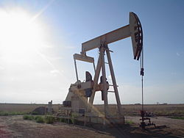
Extraction
Most data extraction and loading takes place on a “batch” basis and data transformations cause a time delay.
Early warehouses were often completely refreshed during the loading process, but as data volumes grew, this became impractical.
“Closed loop” process.

Slide 20

Transformation
The process of understanding the data sources, designing transformations, testing the loading process, and debugging is often the most time-consuming part of deployment.
Transformations are used to remove erroneous data, convert data items to an agreed-upon format, and filter data not considered necessary for the warehouse.

Slide 21
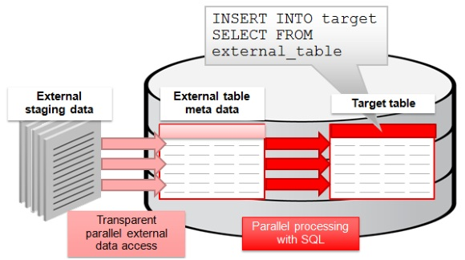
External Tables
External tables allows transparent parallelization inside the database.
You can avoid staging data and apply transformations directly on the file data.

Slide 22
Oracle tools/features for DWH
Oracle Data Integrator (ODI).
Oracle GoldenGate.
Transparent Gateways and Heterogeneous Services.
Transportable Tablespaces.
Transportable Partitions.
Data Pump Fast Import/Export.
Oracle Big Data Connectors.
Notes:
Oracle Data Integrator (ODI)
Acquired by Oracle in 2007, this extraction, transformation, and loading (ETL) tool that handles heterogeneous sources and targets is sometimes referenced as an ELT
tool since transformations are pushed into the target data warehouse. This product has replaced Oracle Warehouse Builder as Oracle’s primary offering for ETL. ODI
features Knowledge Modules that define integration capabilities, including extraction with change data capture, loading and unloading utilities, SQL-based loading
and unloading, and transformation logic SQL. Data Quality options include data quality profiling, batch processing, and address verification. The Knowledge Modules are modifiable. The product architecture includes a development environment that makes use of the Knowledge Modules as templates in declarative design processes and an orchestration agent. ODI can be used for data-based, event-based, and service-based data integration.
Oracle GoldenGate
Acquired by Oracle in 2009, GoldenGate has replaced Oracle Streams as the primary software recommended for log-based replication. Often used for zero downtime
software upgrades, during software migrations, and for low latency transaction replication and recovery, GoldenGate supports a wide variety of data sources and
targets. It is often used to load Oracle-based data warehouses where the need for data transformations is minimal and near real-time updates of the data in the data
warehouse are desired.
Transparent Gateways and Heterogeneous Services
Provide a bridge to retrieve data from non-Oracle sources using Oracle SQL to load an Oracle Database. Heterogeneous Services provide ODBC connectivity to non-
Oracle relational sources. Gateways can optionally provide a higher level of performance when extracting data from non-Oracle sources.
Transportable Tablespaces
Another feature for data movement, Transportable Tablespaces enable rapid data movement between Oracle instances without export/import. Metadata (the data dictionary) is exported from the source and imported to the target. The transferred tablespace can then be mounted on the target. Oracle Database 10g introduced
cross-platform Transportable Tablespaces, which can move a tablespace from one type of system (e.g., Solaris) to another (e.g., Linux).
Transportable Partitions
Oracle Database 11g introduced Transportable Partitions for rapid data movement between Oracle instances.
Data Pump Fast Import/Export
Added in Oracle Database 10g and enabled via external table support, Data Pump is a newer import/export format. Parallel direct path loading and unloading are
supported.
Oracle Big Data Connectors
First available in 2011, Oracle’s Big Data Connectors include an Oracle Loader for Hadoop that pushes the preprocessing of data to be loaded into an Oracle data
warehouse to the source Hadoop Big Data cluster. The result is lessened CPU and I/O impact on the target Oracle Database platform. An Oracle Data Integrator Application Adapter for Hadoop provides ODI Knowledge Modules optimized for Hive and the Oracle Loader for Hadoop. An Oracle Direct Connector for HDFS
and an Oracle R Connector for Hadoop are also provided.

Slide 23
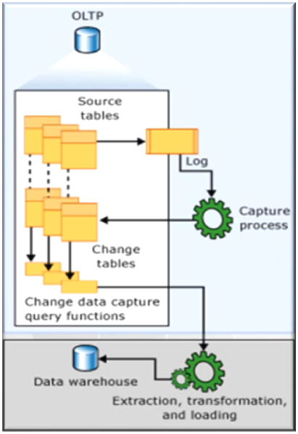
Change Data Capture (CDC)
CDC is a set of software design patterns used to determine (and track) the data that has changed so that action can be taken using the changed data.
Using the SQL MINUS operator, you can obtain the inserted and new versions of updated rows.
Selecting the new and changed data from the source tables based on the value of a specific column (e.g. LAST_UPDATE_DATE).
Oracle Change Data Capture (which is de-supported in 12c).

Slide 24
Overview of ETL and SQL Review
Elias Nema
Senior Software Engineer
Elias_Nema@epam.com

